Slide 1
The Legacy of Log4shell
The Future of DevSecOps
DevOpsDays Chattanooga
2023-11-15
This work is licensed under Attribution-NonCommercial-ShareAlike 4.0 International

Slide 2

Hello World
Paul Novarese
Principal Solutions Architect
Anchore, Inc.
github.com/pvnovarese
Fediverse: @pvn@mas.to
Notes:
Anchore is working to secure the software supply chain
We sponsor open source projects SYFT and GRYPE
Last year I gave a talk on this stage called “learn from log4shell” - it doesn’t matter if you were here for that, this is a self contained discussion though I will go back to a couple of key points

Slide 3

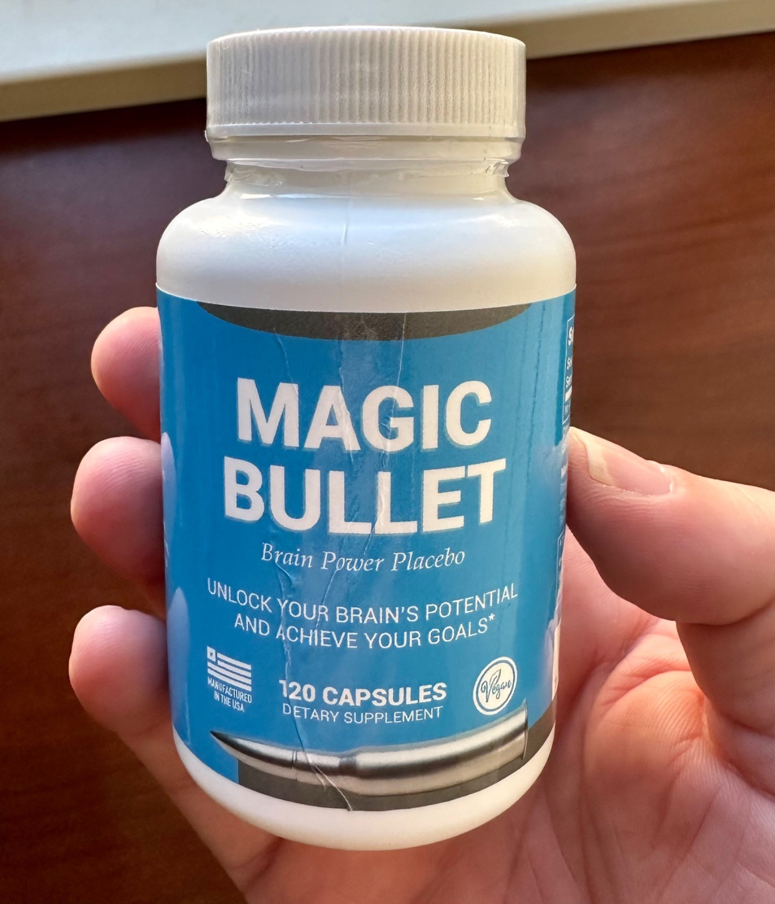
This is not a utopian talk with magic solutions
Notes:
There’s some really bad news, there’s some good news, and maybe a bit of optimism at the end
https://infosec.exchange/@codinghorror/111223082166554360

Slide 4
Agenda
01
Log4Shell Today
02
A Fundamental Shift
03
Software “Supply” Chains
04
Three Big Things
Notes:
I’m not going to give away all the good stuff here on the first slide

Slide 5
The State of Log4Shell Today
Notes:
We’ll start with a quick check on the current status

Slide 6
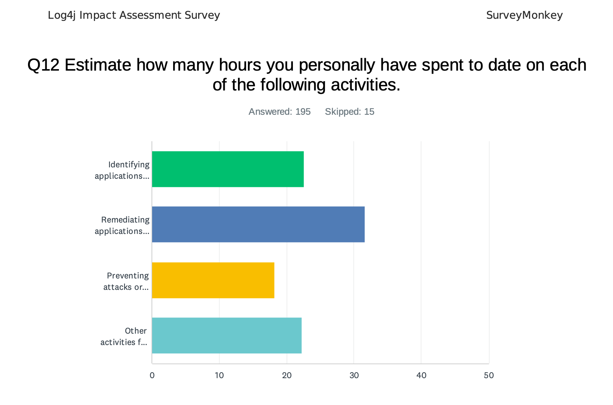
Notes:
This is a slide from last year, just a really rough estimate of time spent immediately reacting to Log4Shell disclosure. Numbers here don’t matter, it’s a lot.
Note: only 65% of respondents indicated that “identifying applications” was part of their role in log4j response.

Slide 7
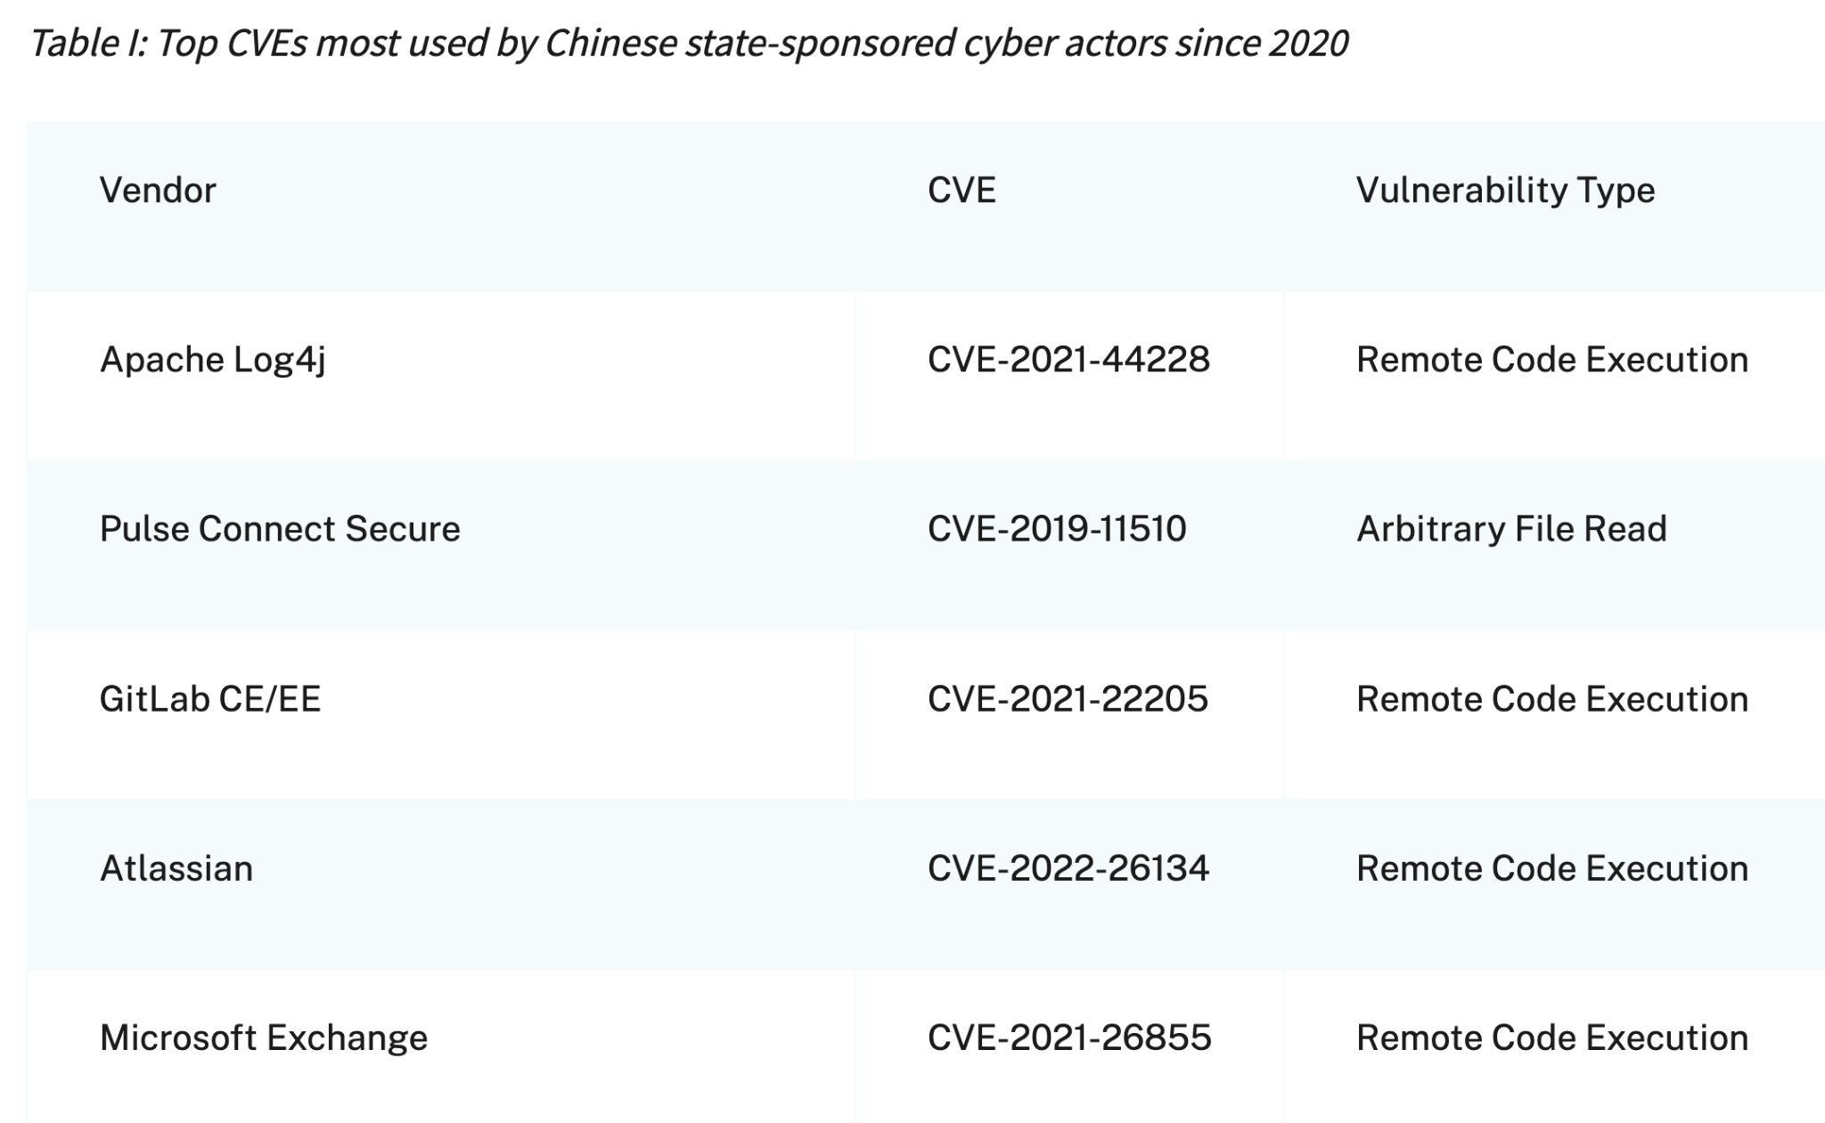
Notes:
It’s been two years and log4shell is still the single most exploited CVE
CISA - cybersecurity and infrastructure security agency
https://www.cisa.gov/news-events/cybersecurity-advisories/aa22-279a

Slide 8
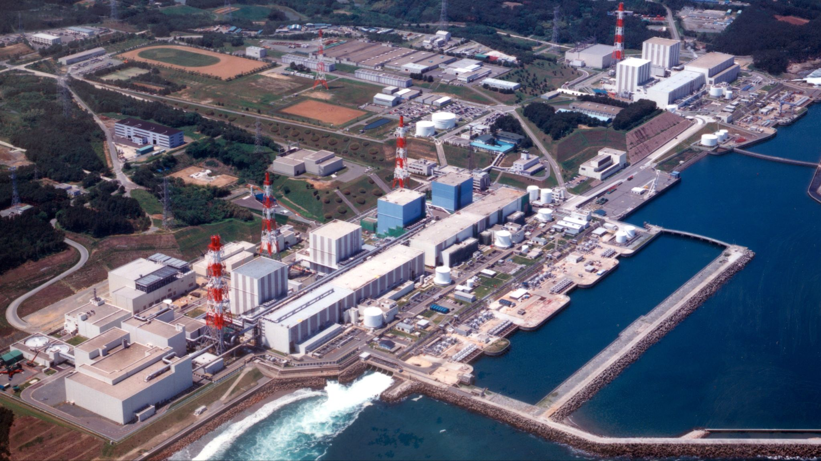
Fukishima Daiichi
Incident: 2011
Cleanup: at LEAST thirty years
Notes:
Fukishima Daiichi
Incident: 2011
Cleanup: at LEAST thirty years

Slide 9
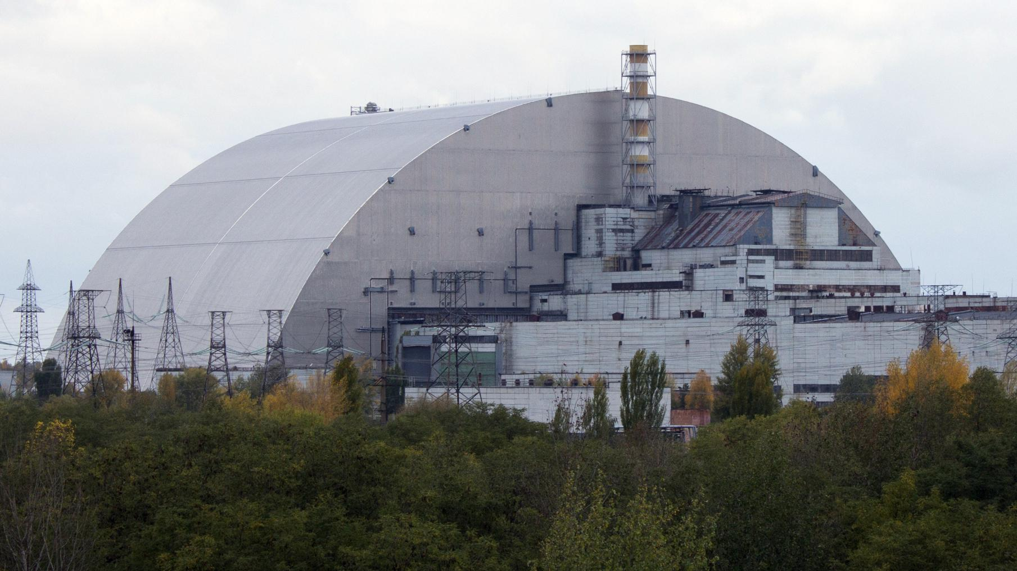
Chernobyl
Incident: 1986
Cleanup: at LEAST until 2065
Notes:
Chernobyl
Incident: 1986
Cleanup: at LEAST until 2065

Slide 10
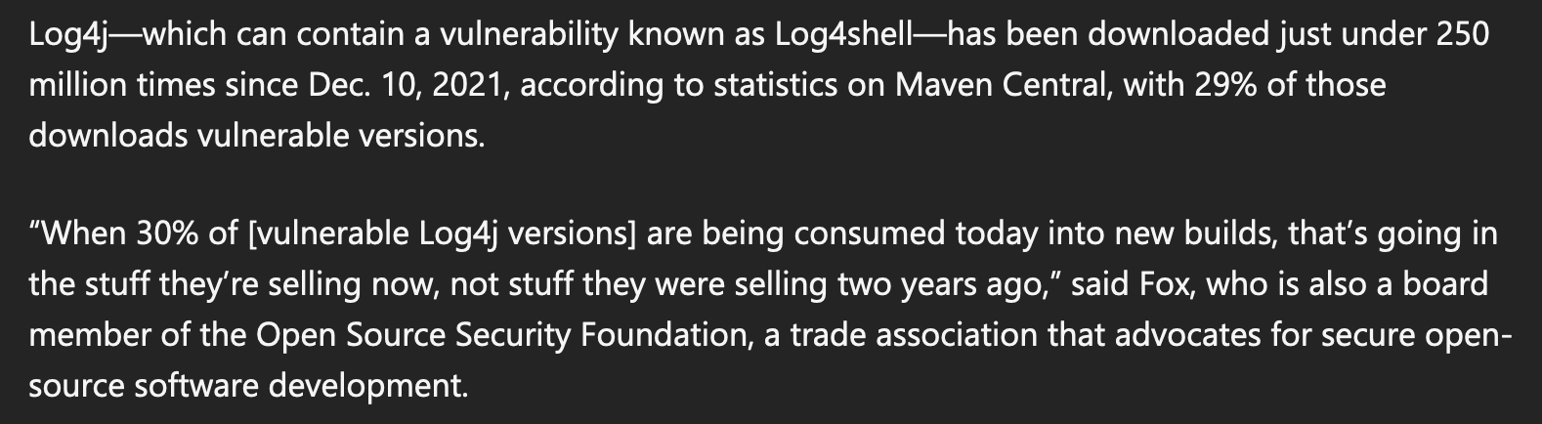
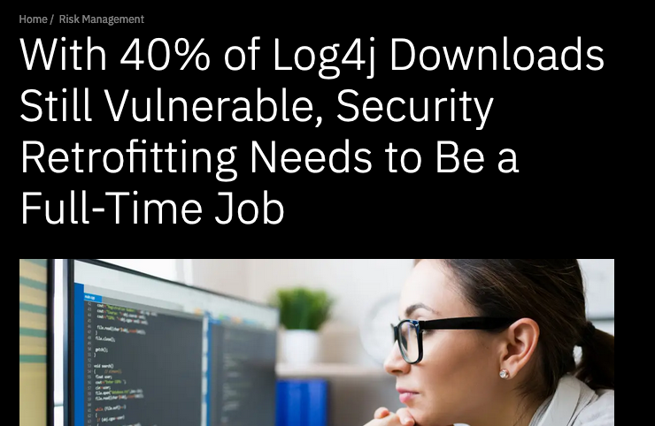
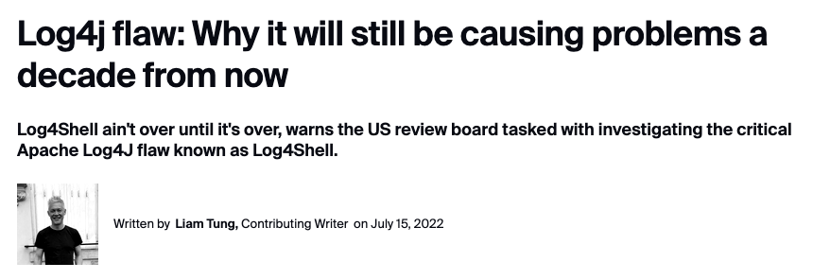
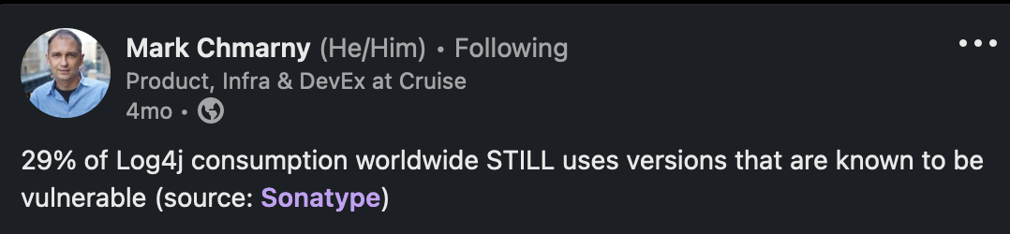
Notes:
In 2023: 40% of Log4j downloads still vulnerable it will still be causing problems a decade from now

Slide 11
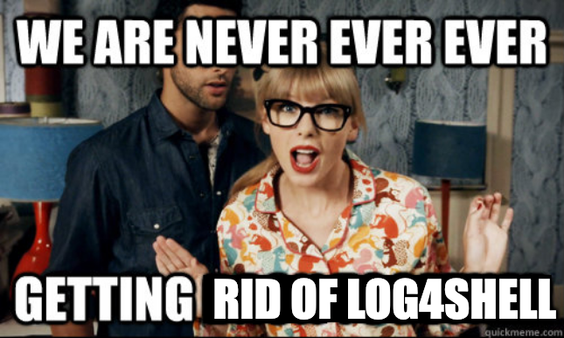
Notes:
In 2023: 40% of Log4j downloads still vulnerable
it will still be causing problems a decade from now
Fukishima: 2011
Chernobyl: 1986

Slide 12
Log4Shell Highlighted a Fundamental Shift
Notes:
How many people here had some log4shell impact?
How many knew they were using log4j before log4shell dropped?
How many had never even heard of log4j before log4shell?

Slide 13

Hidden Risk in the Software Supply Chain
Your App
Software suppliers
60% contain
high risk vulnerabilities
Risk in the Software Supply Chain
Log4j
Attackers are targeting here
Open source
makes up 75%
of applications
Notes:
This is a slide from last year’s talk
You’ve seen this iceberg metaphor. I’ve used this metaphor 100 times, I’ve criticized this metaphor.
They’re attacking the bottom now - that’s a supply chain attack

Slide 14
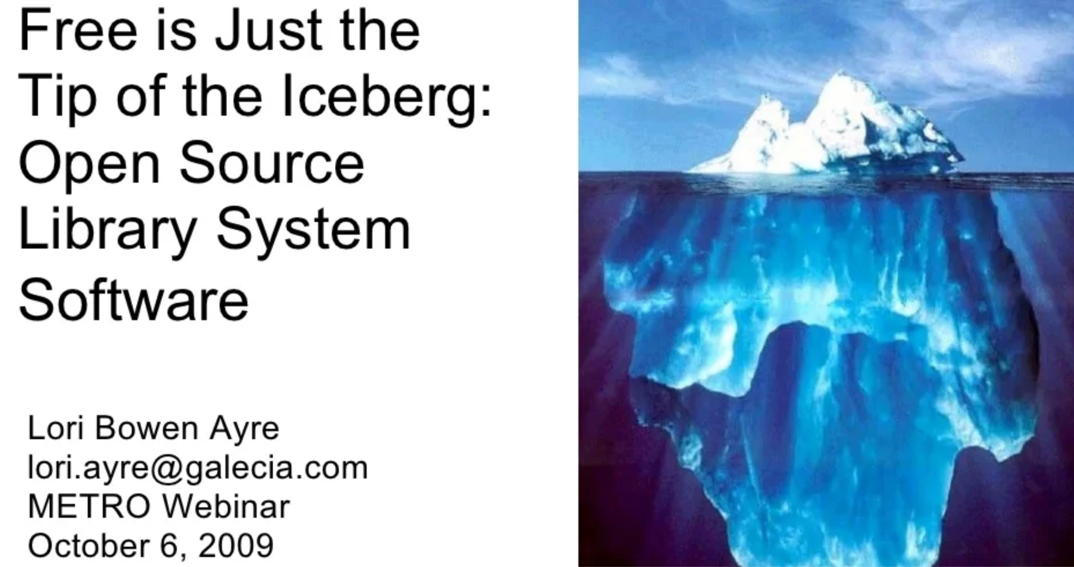
Notes:
This is an OLD metaphor
Things have changed a lot but we’re still thinking about old systems
https://www.slideshare.net/loriayre/open-source-library-system-software-free-is-just-the-tip-of-the-iceberg

Slide 15
Direct Dependencies
Transitive
Dependencies
Attackers are targeting here
Notes:
The top isn’t “your code” - attackers don’t care about your code at all, the top is your direct dependencies
You can only directly control what’s at the top
They’re attacking all of those, but you probably only know about the stuff at the top
Transitive dependencies are a relatively new phenomenon - but our methods of talking about software security predate it and haven’t evolved

Slide 16
This metaphor…
You’ve seen this iceberg metaphor. I’ve used this metaphor 100 times, I’ve criticized this metaphor.
This is an OLD metaphor
Things have changed a lot but we’re still thinking about old systems
https://www.slideshare.net/loriayre/open-source-library-system-software-free-is-just-the-tip-of-the-iceberg
They’re attacking the bottom now - that’s a supply chain attack
But really, the top isn’t “your code” - the top is your direct dependencies, bottom is transitive
You can only directly control what’s at the top
They’re attacking the whole iceberg, but you probably only know about the stuff at the top
The change is largely due to the massive rise in software package managers
The CVE system predates this change and hasn’t really evolved

Slide 17
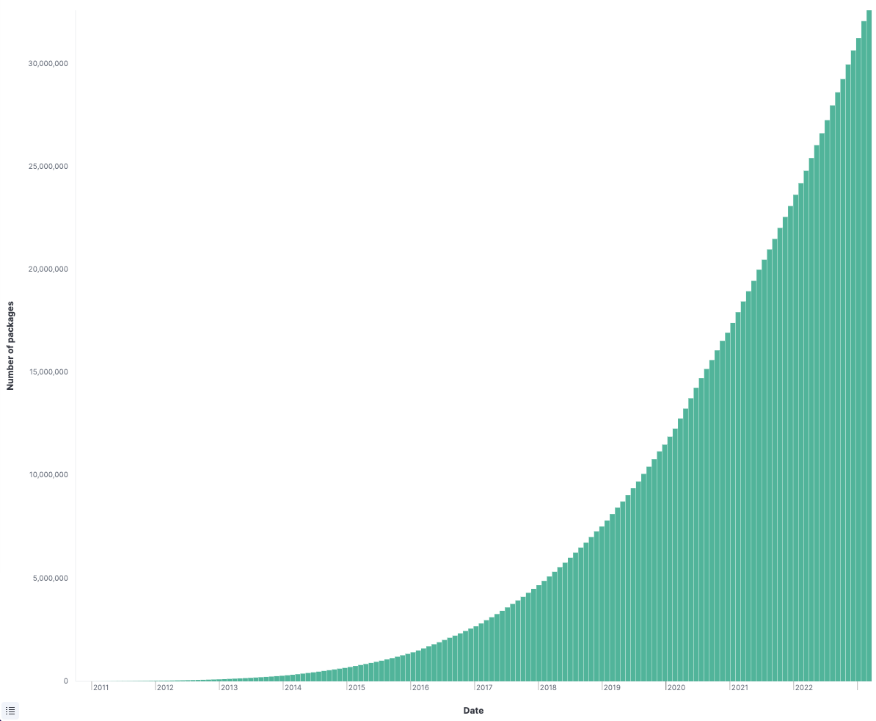
Number of
NPM packages
Notes:
NPM introduced 2010
32 million packages
As of march 2023

Slide 18
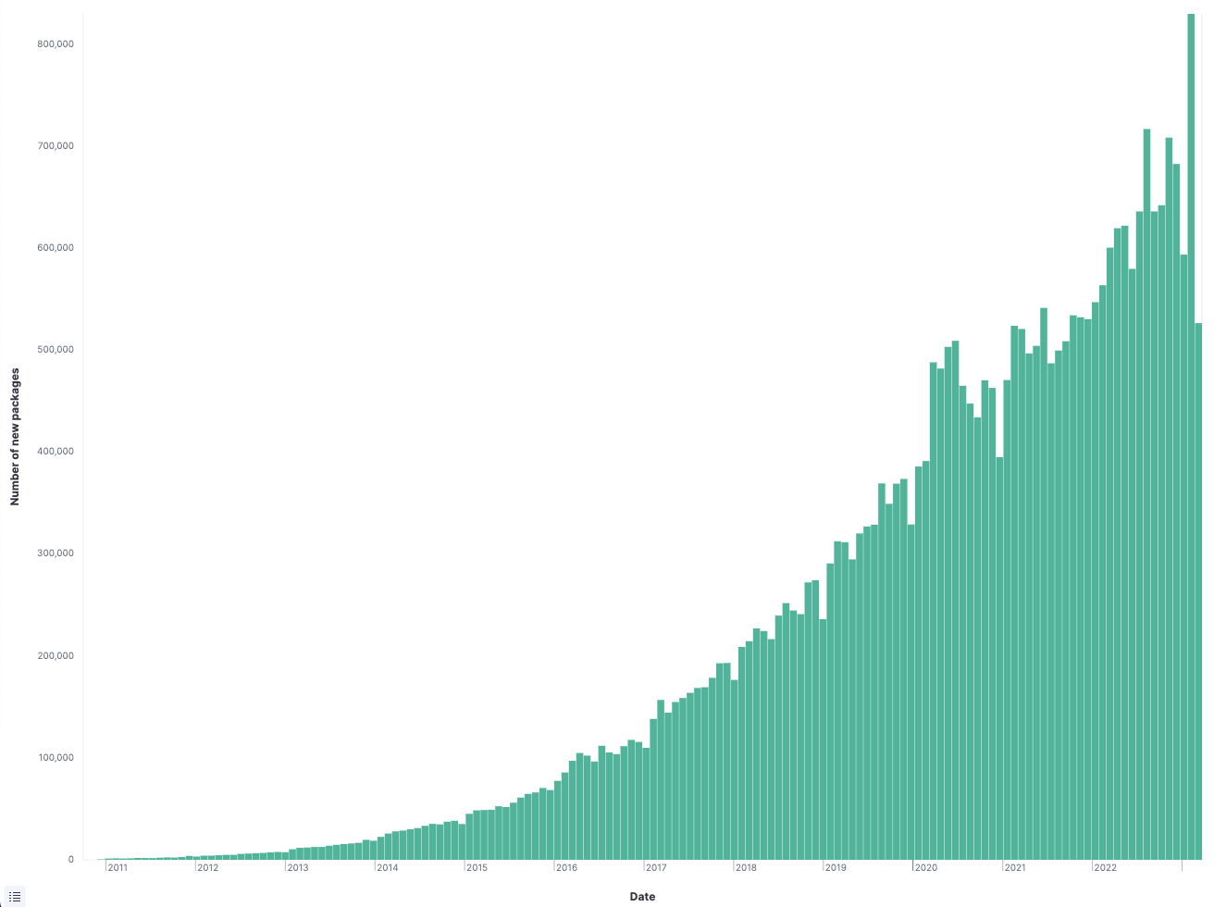
Number of
NEW packages
Notes:
Approaching 1,000,000 new packages per month
Proposal to do security reviews on 10,000 open source projects per year
Clearly this is doomed

Slide 19
Open source is huge
NPM introduced 2010
32 million packages (as of March 2023)
Approx. 1,000,000 new packages **per month**
That’s just NPM!

Slide 20
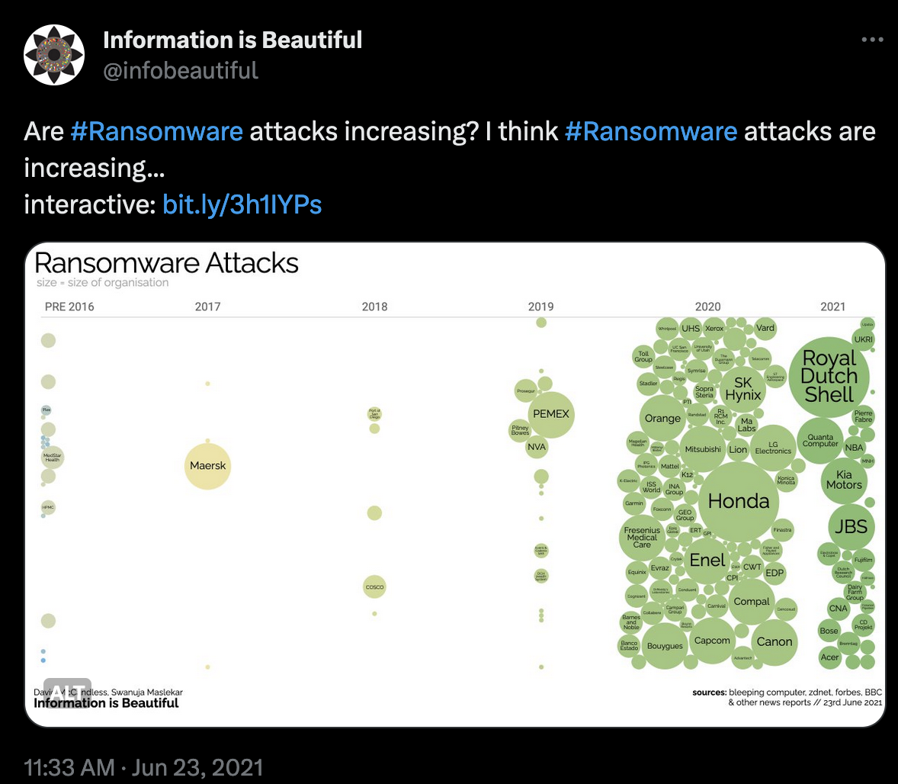
Notes:
https://twitter.com/infobeautiful/status/1407738511265050626

Slide 21
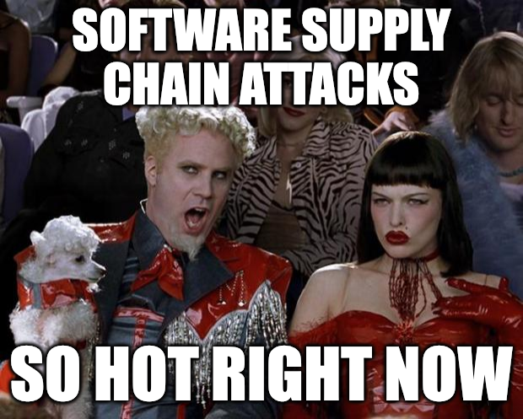
The predictable consequence
Ransomware has exploded along with transitive dependencies and open source in general
I don’t believe in coincidences

Slide 22
Direct Dependencies
Transitive
Dependencies
Attackers are targeting here
Notes:
People spent insane amounts of time just finding log4j, because nobody knew where (or even if) it was hiding
Knowing = Faster Remediation
SBOMs help, a LOT, but… “a phone book is not illuminating”
They aren’t a silver bullet
Scanners aren’t perfect (e.g. can’t penetrate binary blobs, cf. OpenSSL3.)
Not all SBOMs are equal
SBOMs aren’t ubiquitous (yet) (producers aren’t reliably supplying them)
SBOMs are more accurate and useful when producers/maintainers generate them BUT something is better than nothing
SBOM management is hard
Any SBOM generated before an actual build is suspect (transitive deps)
SBOM Everywhere: https://github.com/ossf/sbom-everywhere
I don’t know what the end game is but generating them is better than nothing, figure out the details later

Slide 23
If We Knew What We are Consuming
People spent insane amounts of time just finding log4j, because nobody knew where (or even if) it was hiding
Knowing = Faster Remediation
SBOMs help, a LOT, but… “a phone book is not illuminating”
They aren’t a silver bullet
Scanners aren’t perfect (e.g. can’t penetrate binary blobs, cf. OpenSSL3.)
Not all SBOMs are equal
SBOMs aren’t ubiquitous (yet) (producers aren’t reliably supplying them)
SBOMs are more accurate and useful when producers/maintainers generate them BUT something is better than nothing
SBOM management is hard
Any SBOM generated before an actual build is suspect (transitive deps)
SBOM Everywhere: https://github.com/ossf/sbom-everywhere
I don’t know what the end game is but generating them is better than nothing, figure out the details later

Slide 24
Software “Supply” Chains

Slide 25
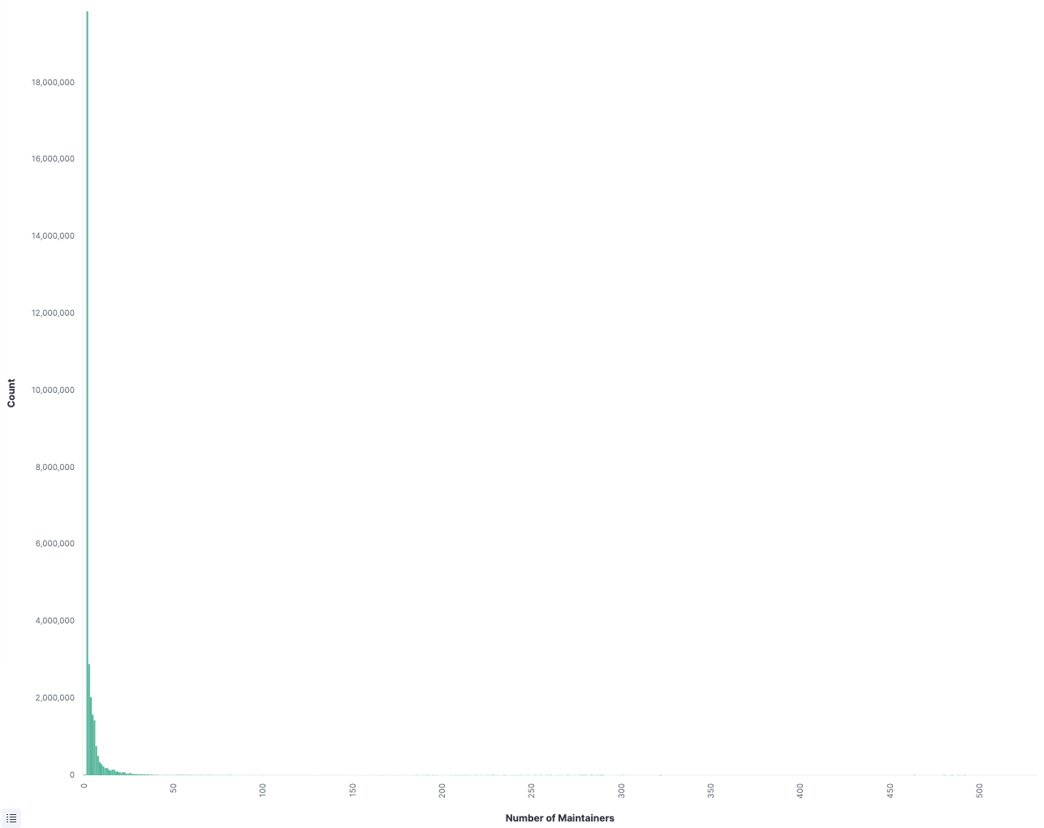
THIS IS NOT
THE AXIS!
An Example Project
Health Metric:
Number of
Maintainers
Notes:
We’ll talk more about “project health metrics” in a minute but this is a bit of data from that same npm data we looked at a minute ago. A **lot** of projects have a single maintainer, and a lot have a single contributor. These are mostly side projects. These guys are NOT suppliers.

Slide 26
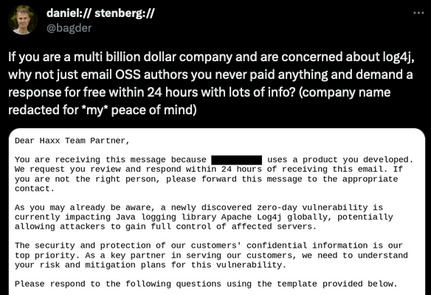
Notes:
https://twitter.com/bagder/status/1484672924036616195

Slide 27
log4shell Timeline
log4j PR #608
log4j 2.15.0-rc1 ships
Official public disclosure CVE-2021-44228
Log4j 2.17.1
29 Nov
6 Dec
10 Dec
17 Dec
24 Nov
1 Dec
9 Dec
13 Dec
Initial disclosure to ASF by Chen Zhaojun (Alibaba)
First evidence of exploit in the wild (per Cloudflare)
Discussion of exploit on minecraft forums, LunaSec coins “Log4Shell”, &c
Log4j 2.16.0
Notes:
Note the gap between disclosure and PR, and between PR and patch. This is a “half day” situation (notes)
https://hypixel.net/threads/psa-there-is-a-fatal-remote-code-execution-exploit-in-minecraft-and-its-by-typing-in-chat.4703238/
https://twitter.com/_r_netsec/status/1469120458083962882
https://twitter.com/eastdakota/status/1469800951351427073

Slide 28


Stop thinking about open source like a vendor
This
Not this
Notes:
Open Source today is (largely) a RESOURCE, not a VENDOR
A supplier means you are transferring responsibility to someone in exchange for money
Getting libraries from Redhat = supplier
Getting stuff from npm - not a supplier
A lot of critical plumbing is maintained by unpaid guys who have day jobs, take vacations, etc.

Slide 29
Summary of Software Supply Chains
Red Hat is a supplier - they assume responsibility in exchange for money
npm is NOT a supplier
A lot of critical plumbing is maintained by unpaid guys who have day jobs, take vacations, etc.

Slide 30
Three Big Things
Notes:
Ok finally, how are we going to make sense of this and move forward?

Slide 31
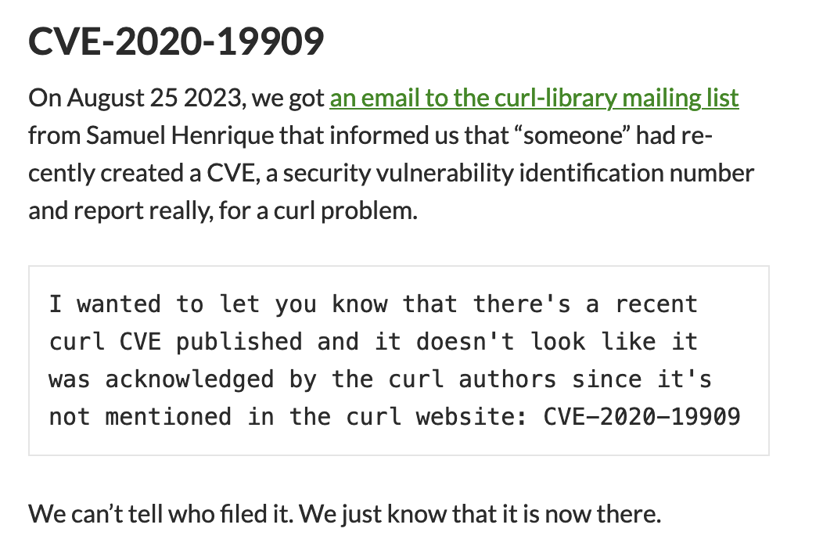
Notes:
Let’s go back and talk about Curl again
Here’s a recent blog post from daniel (this is super infuriating, if you need your blood pressure to go up I recommend this)
There is no transparency or accountability (It’s a 2020 advisory just filed in 2023)
The score is not connected to reality (9.8!)
It’s not even a security vulnerability!

Slide 32
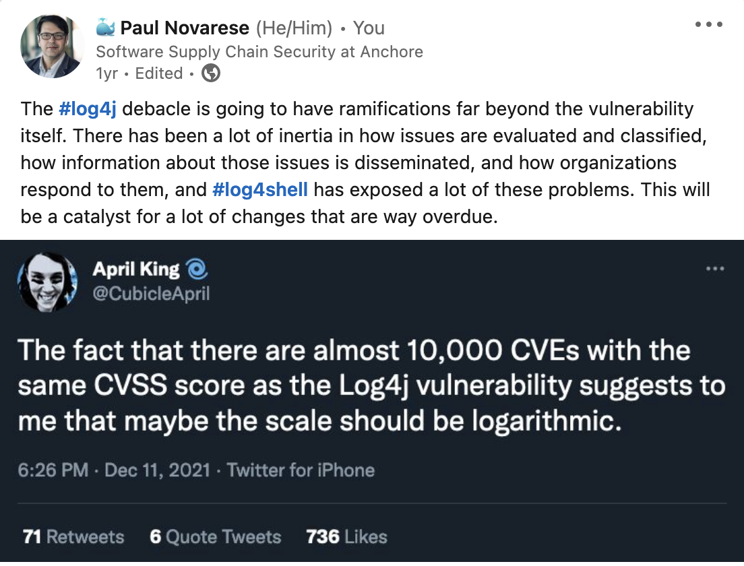
Notes:
I posted this in December 2021 right after log4shell dropped, a year later I basically gave up and said this was completely wrong, and now another year later I think it may end up being correct, ultimately. So, Big Thing #1 - if not CVE/CVSS, then what?
New data sources, scoring systems, and frameworks to disseminate more context:
GHSAs (more transparent than CVEs)
CISA KEV, EPSS, VEX, CSAF, &c
OpenSSF Malicious Packages Repository
https://twitter.com/CubicleApril/status/1469825942684160004
https://www.linkedin.com/posts/novarese_log4j-log4shell-activity-6876206319238463488-8bEA

Slide 33
Big Thing #1: If Not CVE/CVSS, Then What?
GHSAs (more transparent than CVEs)
CISA KEV, EPSS, VEX, CSAF, &c
OpenSSF Malicious Packages Repository
GitHub Insights and other project health metrics
This is (currently) a very manual process
But it’s getting a lot easier
Notes:
Github advisories start with CVE data but enhance it, there’s a transparent process for discussion and refinement

Slide 34
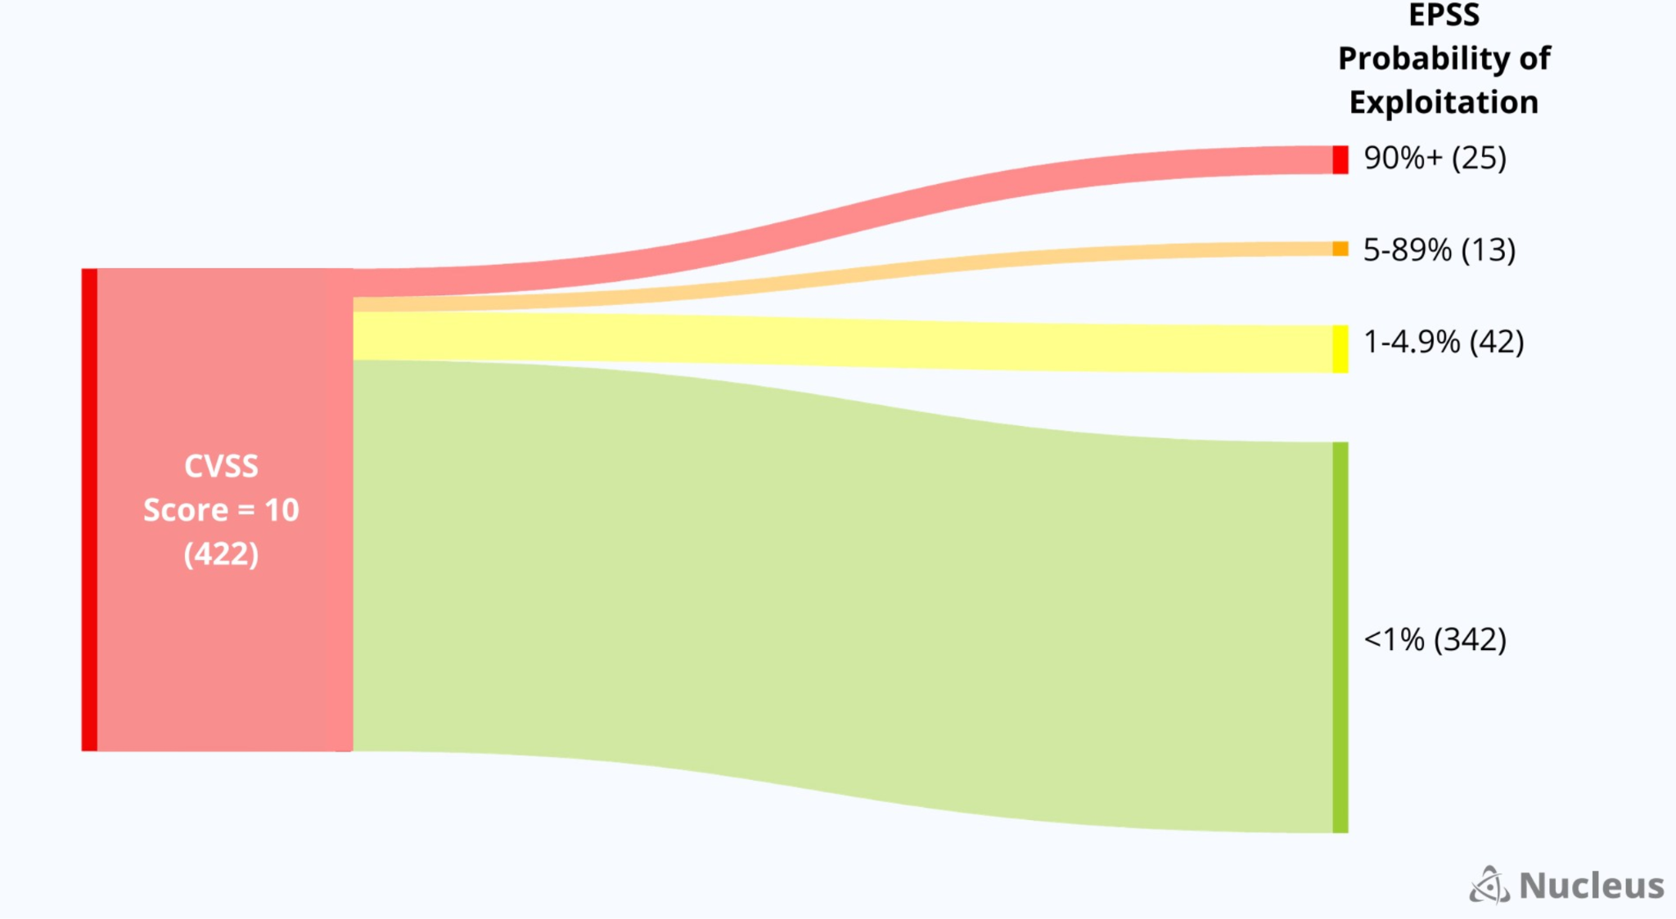
Notes:
So, Big Thing #1 - if not CVE/CVSS, then what?
New data sources, scoring systems, and frameworks to disseminate more context:
GHSAs (more transparent than CVEs)
CISA KEV, EPSS, VEX, CSAF, &c
OpenSSF Malicious Packages Repository
GitHub Insights and other project health metrics
This is (currently) a very manual process
But it’s getting a lot easier
Patrick Garrity https://www.linkedin.com/posts/patrickmgarrity_the-evolution-of-patricks-sankey-matics-activity-7118334146728357888-zxxn/

Slide 35
Big Thing #2: Project Health/Insights
This is PROACTIVE (the better advisory data, scoring etc is about reactive improvements)
This is (currently) a manual process (getting easier)
Evaluating project health isn’t directly about safety, it’s about tracking all of those deps in the iceberg,
Are the projects you’re depending on healthy, will you be able to work with them?
Notes:
Some people want (e.g.) positive IDs on contributors (this is not happening) - they think they can find boogeymen putting traps into open source
What happens when it hits the fan?

Slide 36
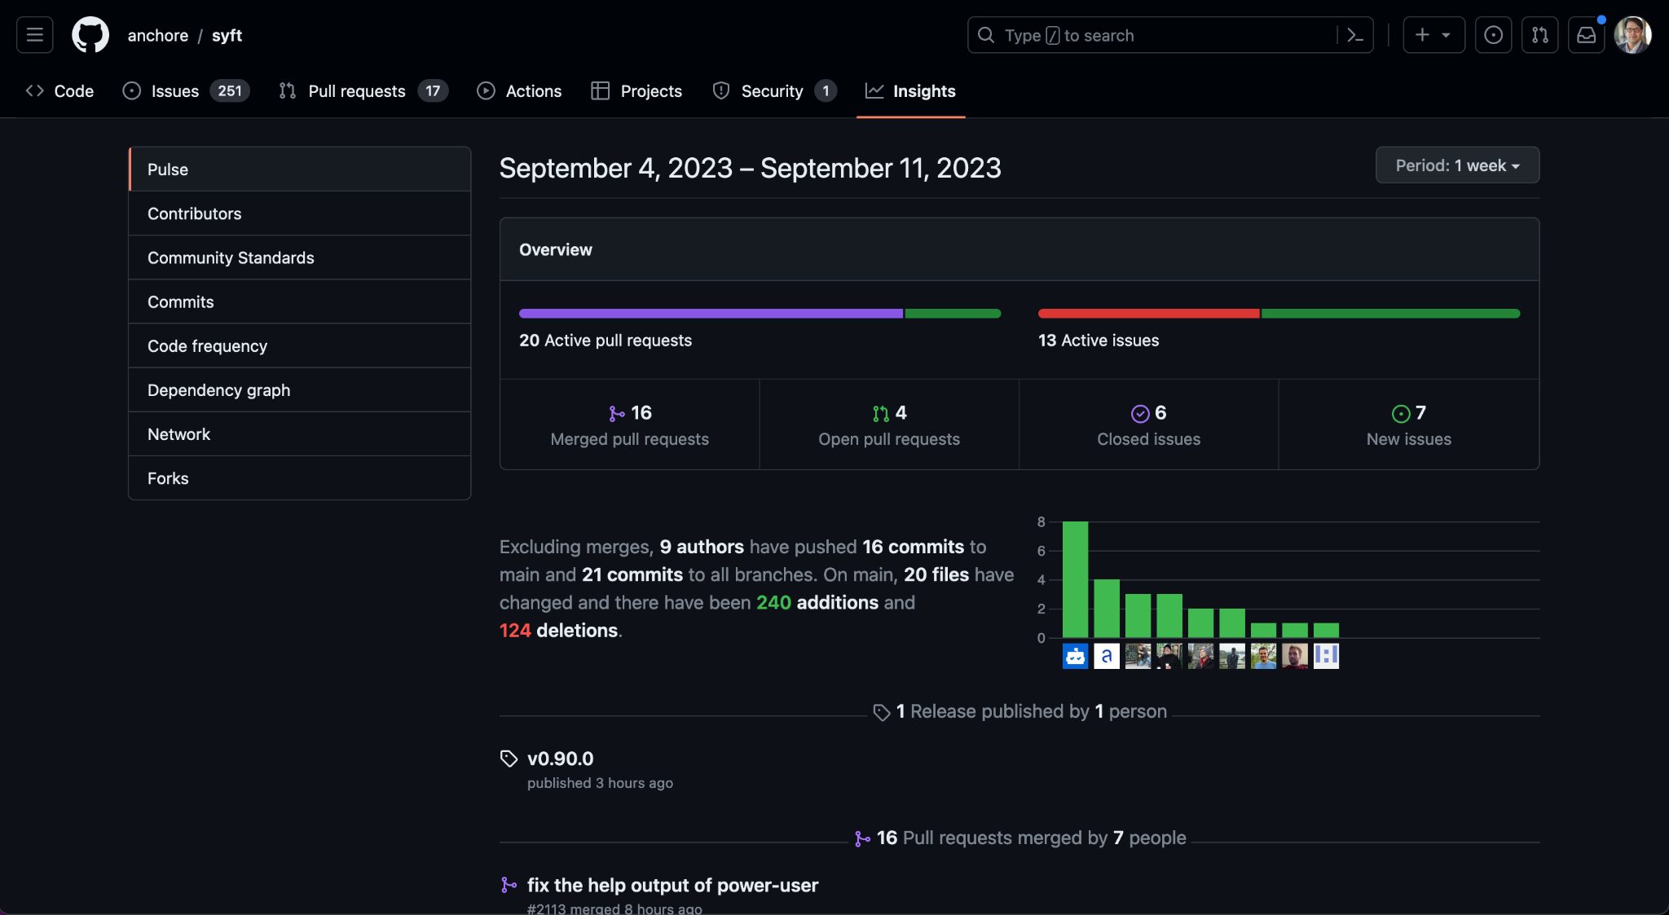
Notes:
Big thing #2 - Project Health
This is PROACTIVE (the better advisory data, scoring etc is about reactive improvements)
This is (currently) largely a manual process
But it’s getting a lot easier
I see a lot of people asking for more data like this but they want stuff like positive IDs on contributors
They think they can find boogeymen putting traps into open source
But Evaluating project health isn’t directly about safety, it’s about tracking all of those deps in the iceberg,
What happens when it hits the fan?
Are the projects you’re depending on healthy, will you be able to work with them?

Slide 37
Big Thing #3: Twitter is Dead
Twitter was incredibly central to Log4Shell reaction, forming consensus, and generally just figuring out what was happening
If log4shell dropped today, this reaction/recovery would be notably worse because of infosec splintering to (e.g.) mastodon, linkedin, bsky, threads
None of these networks have the critical mass that Twitter had and it doesn’t seem to be improving
Notes:
Some people want (e.g.) positive IDs on contributors (this is not happening) - they think they can find boogeymen putting traps into open source
What happens when it hits the fan?

Slide 38
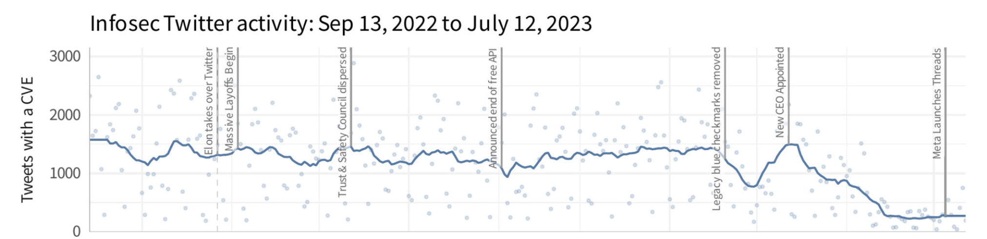
Notes:
Big thing #3 - twitter is completely dead for infosec, I’m not really going to dig into WHY but if you want to, check the notes
The reality is that if log4shell happened today it would be a lot messier
People have left twitter, gone to mastodon, linkedin, bsky, threads, tiktok, idk
There’s no critical mass in any one location
https://www.cyentia.com/the-death-of-infosec-twitter/

Slide 39
Big Changes
Better Metrics and Data Sources are Coming
Tracking Dependencies is More Proactive
Twitter is Over
Notes:
Github advisories start with CVE data but enhance it, there’s a transparent process for discussion and refinement

Slide 40
Call to Action
SBOM Everywhere: https://github.com/ossf/sbom-everywhere
I don’t know what the end game is but generating them is better than nothing, figure out the details later
The (first two) “big things” are still very embryonic and probably not ready for prime time
but tools are starting to adopt a lot of this
SBOMs: https://github.com/anchore/syft
Vulnerabilities: https://github.com/anchore/grype
Webinars: https://anchore.com/webinars/

Slide 41
Recap
Log4Shell is radioactive and immortal
How software gets made has changed
We don’t know what’s in our software
We don’t know who is supplying it
We have to change how we evaluate it
GitHub is uniquely positioned
Try to be proactive
Notes:
Radioactive disasters take forever to clean up
It’s hard to know what’s in our own software, it’s even harder for other people’s software
The data we consume today is bad, but improvements are emerging
Tracking dependencies is critical, this is a relatively new problem and most people aren’t even aware of it
This new stuff is TOO new, don’t feel like you have to drop everything and do it today, the tooling is immature
Build SBOMs, that tooling is pretty decent though there are still more improvements coming

Slide 42
Q&A
Download Syft
Download Grype
https://github.com/anchore/syft
https://github.com/anchore/grype
Let us know if you like it by giving us a star on GitHub
Get an invite to our open source community Slack: https://anchore.com/slack/
These slides and lab examples archived here: https://github.com/pvnovarese/2023-11-legacy-of-log4shell

Slide 43
Notes, &c.

Slide 44
Footnotes
Log4Shell’s immortality: https://www.zdnet.com/article/log4j-flaw-why-it-will-still-be-causing-problems-a-decade-from-now/ https://securityintelligence.com/articles/log4j-downloads-vulnerable/
possible origin of the iceberg - https://www.slideshare.net/loriayre/open-source-library-system-software-free-is-just-the-tip-of-the-iceberg
Open Source is Bigger Than You Can Imagine - https://anchore.com/blog/open-source-is-bigger-than-you-imagine/
log4j survey etc - https://anchore.com/log4j/
Half Day Vulnerabilities - https://github.com/Aqua-Nautilus/CVE-Half-Day-Watcher
The Death of Infosec Twitter - https://www.cyentia.com/the-death-of-infosec-twitter/
Patrick Garrity discussing EPSS and Improved Metrics: https://www.linkedin.com/posts/patrickmgarrity_the-evolution-of-patricks-sankey-matics-activity-7118334146728357888-zxxn/
Various tweets &c: https://twitter.com/CubicleApril/status/1469825942684160004 https://www.linkedin.com/posts/novarese_log4j-log4shell-activity-6876206319238463488-8bEA https://twitter.com/bagder/status/1484672924036616195 https://lists.haxx.se/pipermail/daniel/2023-September/000032.html

Slide 45
Projects and Data Sources
OpenSSF Malicious Packages Repository: https://openssf.org/blog/2023/10/12/introducing-openssfs-malicious-packages-repository/
Common Security Advisory Framework: https://oasis-open.github.io/csaf-documentation/
Exploit Prediction Scoring System: https://www.first.org/epss/
CISA Known Exploited Vulnerability Catalog: https://www.cisa.gov/known-exploited-vulnerabilities-catalog
Vulnerability Exploitability Exchange: https://cyclonedx.org/capabilities/vex/
GitHub Advisory Database: https://github.com/advisories
GitHub Insights: https://docs.github.com/en/issues/planning-and-tracking-with-projects/viewing-insights-from-your-project/about-insights-for-projects
Open Source Insights: https://deps.dev/

Slide 46
Reading List
CVEs CWEs CVSS and It's Discontents: https://www.linkedin.com/pulse/cves-cwes-cvss-its-discontents-sherif-mansour
Open Source Security Podcast Episode 392 – Curl and the calamity of CVE: https://opensourcesecurity.io/2023/09/10/episode-392-curl-and-the-calamity-of-cve/
I am not a Supplier:: https://www.softwaremaxims.com/blog/not-a-supplier https://opensourcesecuritypodcast.libsyn.com/episode-365-i-am-not-your-supplier-with-thomas-depierre
Shedding Light on CVSS Scoring Inconsistencies: https://arxiv.org/abs/2308.15259
The Massive Bug at the Heart of NPM: https://blog.vlt.sh/blog/the-massive-hole-in-the-npm-ecosystem
My previous DevOpsDays 2022 talk (Learn From Log4Shell): https://www.youtube.com/watch?v=PlNtIL_oN0k https://github.com/pvnovarese/2022-devopsdays
Probably Don’t Rely on EPSS Yet: https://insights.sei.cmu.edu/blog/probably-dont-rely-on-epss-yet/
CVE-2020-19909 is everything that is wrong with CVEs: https://daniel.haxx.se/blog/2023/08/26/cve-2020-19909-is-everything-that-is-wrong-with-cves/
Do SBOMS Need VEX?: https://www.linkedin.com/posts/aph10_sbom-softwaresupplychainsecurity-vex-activity-7108017924384137216-VARV/
State of the Software Supply Chain: https://www.sonatype.com/hubfs/9th-Annual-SSSC-Report.pdf
A Study on Navigating Open-Source Dependency Abandonment: https://courtney-e-miller.github.io/static/media/WeFeelLikeWereWingingIt.dc3c76d3b3c2d12f4fee.pdf
Few Open Source Projects are Actively Maintained: https://www.infoworld.com/article/3708630/report-finds-few-open-source-projects-actively-maintained.html

Slide 47
Log4Shell Reading List
Dealing with log4shell (detection, mitigation, workarounds): https://cloudsecurityalliance.org/blog/2021/12/14/dealing-with-log4shell-aka-cve-2021-44228-aka-the-log4j-version-2/
Keeping up with log4shell (post mortem) https://cloudsecurityalliance.org/blog/2021/12/16/keeping-up-with-log4shell-aka-cve-2021-44228-aka-the-log4j-version-2/
Mysterious tweet hinting at the exploit: https://twitter.com/sirifu4k1/status/1468951859381485573
Another mysterious tweet: https://twitter.com/CattusGlavo/status/1469010118163374089
“THE” pull request: https://github.com/apache/logging-log4j2/pull/608
Cloudflare digs for evidence of pre-disclosure exploits in the wild: https://twitter.com/eastdakota/status/1469800951351427073

Slide 48
Glossary
CVE - Common Vulnerabilities and Exposures - https://cve.mitre.org/
CVSS - Common Vulnerability Scoring System - https://nvd.nist.gov/vuln-metrics/cvss CISA - cybersecurity and infrastructure security agency - https://cisa.gov KEV - Known Exploited Vulnerabilities - https://www.cisa.gov/known-exploited-vulnerabilities-catalog
EPSS - Exploit Prediction Scoring System - https://www.first.org/epss/
SBOM - Software Bill of Materials - https://www.cisa.gov/sbom
VEX - Vulnerability Exploitability eXchange - https://github.com/openvex/spec
CSAF - Common Security Advisory Framework - https://oasis-open.github.io/csaf-documentation/ GHSA - GitHub Security Advisory - https://github.com/advisories
OpenSSF - Open Source Security Foundation - https://openssf.org/

Slide 49
SBOM Takeaways
00
SBOMs enable continuous, automated security/compliance checks, reduce time spent identifying and remediating issues
01
SBOMs improve a lot of things but do not solve every problem you have
02
Log4j is extremely easy to find, OpenSSL 3 is often obscured
03
SBOMs are more effective when created by maintainers rather than consumers, but something is better than nothing

Slide 50
SBOM Reading List
Making Better SBOMs: https://kccncna2022.sched.com/event/182GT/ – https://www.youtube.com/watch?v=earq775L4fc
Reflections on Trusting Trust: https://www.cs.cmu.edu/~rdriley/487/papers/Thompson_1984_ReflectionsonTrustingTrust.pdf
Generate sboms with syft and jenkins: https://www.youtube.com/watch?v=nMLveJ_TxAs
Profound Podcast - Episode 10 (John Willis and Josh Corman): https://www.buzzsprout.com/1758599/8761108-profound-dr-deming-episode-10-josh-corman-captain-america
GitHub Self-Service SBOMs: https://github.blog/2023-03-28-introducing-self-service-sboms/

